Slide 1
Computer Networking

Slide 2

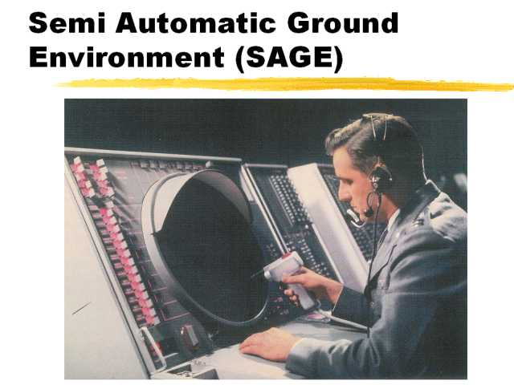
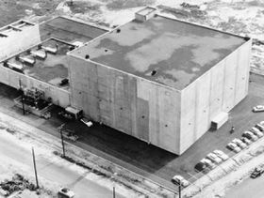
Who made it
The first recorded use of computer network can be seen as early as the 1950’s with the invention of the sage(Semi-Automatic Ground Environment)
This was used at radar sites to create and image on single airspace. This network used multiply computers
These technology were used in the cold war by nomad
Jay Forrester was the one who drove the plans for the Sage
This was commissioned by the united states government
Internet connection were used on 6 August 1991,

Slide 3
What is it
computer network are an amount of computers that connected to each other. The reason they are connected is so they can share resources. It is often used in work spaces. An connection to the internet is an computer network.
Almost everything thing you use has an network connection.
The computers in this class room have are connected to an network.

Slide 4
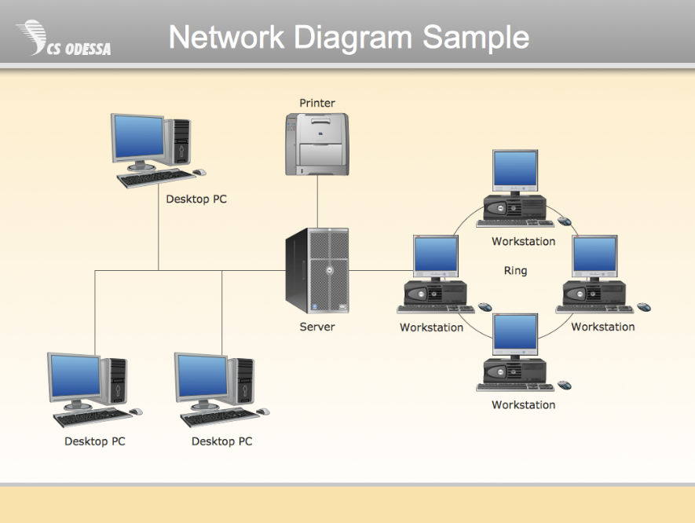
How does it work
There are different types of connection
An LAN connect is local connect used to share information. For example it could be an printer. LAN connection can wireless or wired. An wireless connection could be an printer. An wired printer can be an Ethernet cable connected to a router
If you have direct connection it will be faster

Slide 5
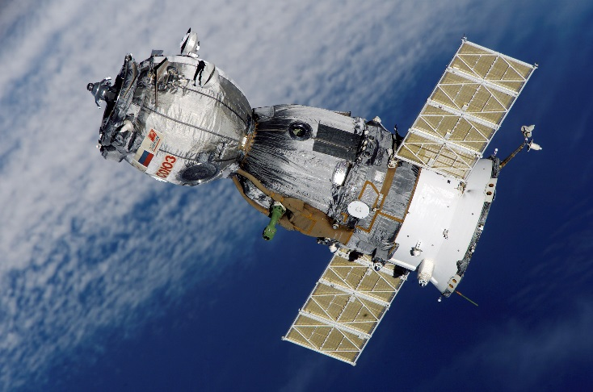
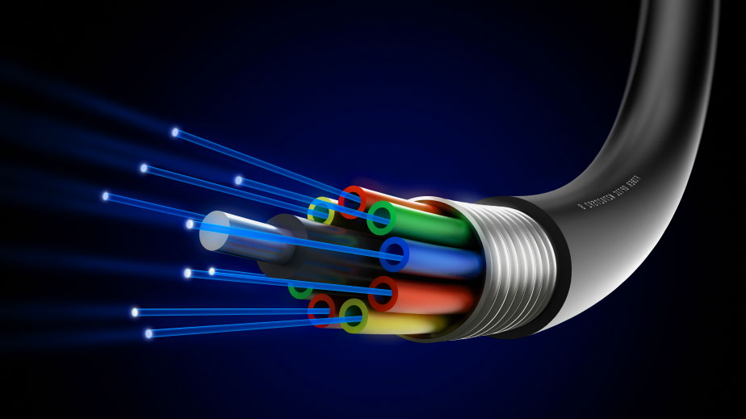
Innovations in the field
Fibered optics is staring to be used in Ethernet like cable
Fiber technology is faster than the others, also it has immunity for interface from other devices
Satellite are launched into the atmosphere of our plant. The satellite sent signal back and forth. The satellite has an advantage of being high so it can reach other networks

Slide 6
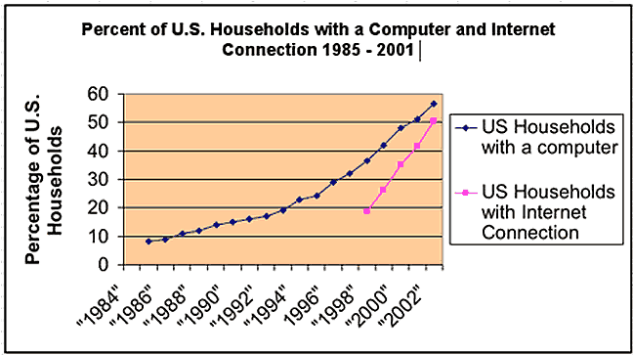
Popularization
Computer network became more popular with the acceptance of computers in our society.
Computer became an household tool in the 90’s
Computers are more popular than ever
They are used in the work place and at home

Slide 7
References
http://study.com/academy/lesson/what-is-a-computer-network-types-definition-quiz.html
https://en.wikipedia.org/wiki/Computer_network
http://www.conceptdraw.com/samples/resource/images/solutions/network-diagram/network-diagram-Network-Diagram-Sample.png

